Slide 1
Make a Baby Activity!
Using chromosomes to determine what our baby will look like!

Slide 2
Step 1: Make sure that everyone picked up the right resources
Everyone needs a white packet
Boys need the Male chromosomes
Females need the female chromosomes

Slide 3
Step 2: Use the letters on the chromosomes to determine your traits.
From looking at your CHROMOSOMES (colored sheets) you will determine what trait it is used for (GENOTYPE) and what your trait will look like (PHENOTYPE). FRONT PAGE!!!!!!!!!!
GENOTYPE=the GENES you get
DESCRIBE in LETTERS
PHENOTYPE=Physical Appearance
DESCRIBE in WORDS

Slide 4
Step 3: Once you have filled out the entire front page, you will cut out your chromosomes
Use scissors to cut out your chromosomes from your chromosome pages.
Place all your chromosomes in your paper bag.
Make sure that your bag is either labeled EGG or SPERM.
Depending on if you are a male or female.

Slide 5
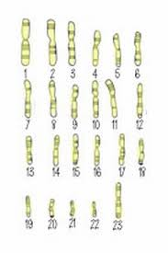
Step 4: Now shake your Gonads! And randomly select 23 of your 46 chromosomes
Shake your paper bag to mix up all your chromosomes
Please do not break the bag!!!
Randomly select 23 chromosomes and glue them in your ZYGOTE cell (page).
YOU CANNOT HAVE 2 OF THE SAME CHROMOSOME
If you already selected a chromosome #1, then throw the other one away.

Slide 6
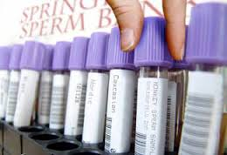
Step 5: Go to the correct gamete donor bank facility to find the other parent
If you are a boy=go to the egg donor bank to find an egg
If you are a girl=go to the sperm donor bank to find a sperm

Slide 7
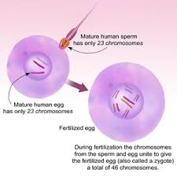
Step 6: Now that you have 2 parents (egg and sperm) , we can complete the zygote cell
Cut out the chromosomes from your sperm or egg and place them by chromosome number in your zygote karyotype.
Now you have the full number of chromosomes needed (Diploid)
2n=46

Slide 8
Step 7: Now look at your chromosomes and determine what traits your baby will have.
Look at your ZYGOTE KARYOTYPE (baby’s chromosomes) and fill out page 3.
Look at each chromosome to determine the letters (genotype) and then find out what the baby’s physical appearance will be (phenotype)

Slide 9
Step 8: Now draw what your baby’s appearance will be!!
Find suggestions on page 4 to help draw your baby’s physical appearance.
Draw your baby on page 5!

Slide 10
Step 9: Answer discussion questions on very back page.
Answer to #1: RANDOM ASSORTMENT

